Slide 1
Oil Diffuser
Student’s Name
Institution
Date

Slide 2
My Personal Motivators
Oil diffusers
https://www.nytimes.com/wirecutter/reviews/best-essential-oil-diffusers/

Slide 3
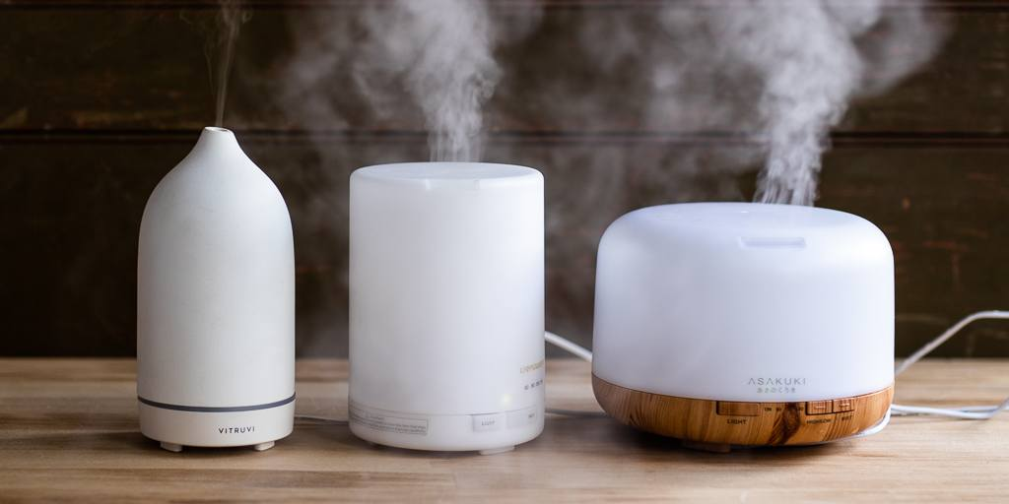

Slide 4
Appealing Advertising
I would buy the oil diffuser product because:
-It has a clean design that looks better than other products.
It has a strong stream of mist that covers the whole house (Shannon Palus, 2020).
It is affordable to purchase and works better than expensive ones.
It is easy to wipe it out when cleaning.

Slide 5
Appeal of the product
My lifestyle of fashion would be enhanced through the use of oil diffuser.
Smelling nice at all times is my ambition and major goal.
The emotional appeals of the ad
The tasty smell of the oil diffuser can make children mistake it for an edible substance (Shannon Palus, 2020). It made me understand the appealing nature of the oil diffuser to my fashion needs.

Slide 6
Study Shows
https://www.dma-solutions.com/thecoreblog/marketing-101-5-types-of-marketing-appeals
Marketers use methods such as emotional, fear, logical, humor, and bandwagon appeals.
Influence of these methods allow marketers attract consumers on the products that are offered (DMA Solutions Team, 2021).
Marketers use these methods to discourage people on bead eating habits, create a persuasive language, humor and logic on products.
Marketers can demonstrate to their target audience about a product to make it relatable.

Slide 7
Study Show
Logic appeal
Facts about the oil diffuser were relayed by the advert. For instance, the smell of the oil diffuser was strong and occupied a large space.
The cost of the oil diffuser was affordable (DMA Solutions Team, 2021). It appealed to me to that I could make purchase of the product.
Also, keeping the oil diffuser away from children is a logical appeal. Children could mistake the nice smell for something edible.

Slide 8
Study Show
https://www.amazon.com/gp/customer-reviews/R33Z16LCG6H9CZ/ref=cm_cr_arp_d_viewpnt?ie=UTF8&ASIN=B00NOAKUBM#R33Z16LCG6H9CZ
I loved it straight out of the box, that is until I used it. I really, really, really wanted to love this diffuser, especially because it was everything I wanted in a diffuser! Ample amount of water storage, modern and non-bamboo model with rotating colors were just some of the features of the diffuser that I loved. And to be honest, I even loved the packaging! But after about 30-45 minutes of use, I noticed a small puddle around the bottom of the diffuser. At first I thought it was just from random droplets that formed at the top of the cover and made its way down to the desk. So I dried everything off and started it again, and voila, there is goes again. Random puddles form at the bottom of the diffuser because of a hole that's manufactured to be there, but weirdly leaks from it.one of the pictures shows exactly where the droplet comes out of. Hope this was a helpful review. Other people may not have this problem!

Slide 9
Comment review
The comments are positive about the oil diffuser only for a random puddle at the bottom of the product that caused confusion. The puddle is found at the bottom of the diffuser but seems it to be manufactured around the hole in the product. The blog was helpful through reviewing the comments of other customers. Positive comments encouraged me to plan on purchasing the oil diffuser.

Slide 10
References
DMA Solutions Team. September 7, 2021. 5 Types of Marketing Appeals to Use to Captivate Your Audience. Retrieved from https://www.dma-solutions.com/thecoreblog/marketing-101-5-types-of-marketing-appeals
Shannon Palus. December 11, 2020.The Best Essential Oil Diffusers. Retrieved from https://www.nytimes.com/wirecutter/reviews/best-essential-oil-diffusers/

